Slide 1
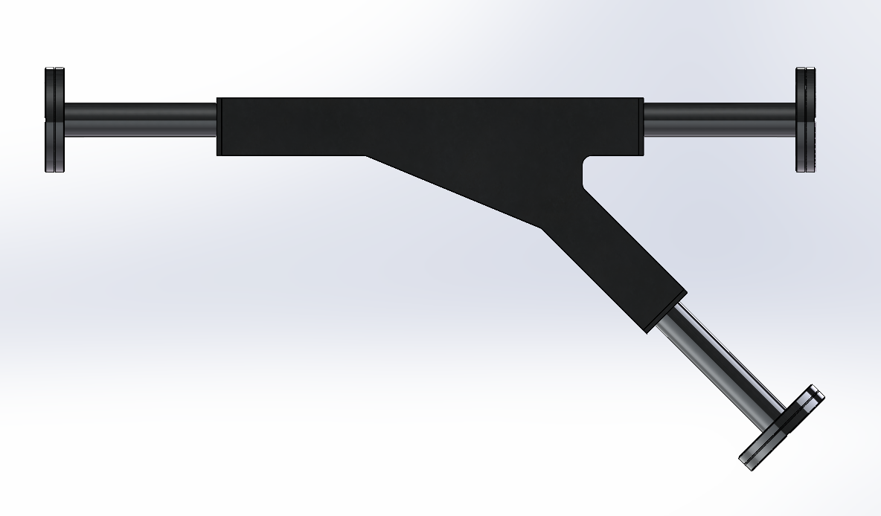
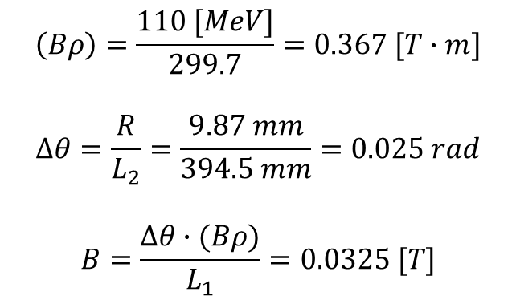
L₂ = 394.5 mm
$$\left(Bρ\right)=\frac{110 [MeV]}{299.7}=0.367 [T∙m]$$
$$∆θ=\frac{R}{L_{2}}=\frac{9.87 mm}{394.5 mm}=0.025 rad$$
$$B=\frac{∆θ∙(Bρ)}{L_{1}}=0.0325 [T]$$
L₁ = 282.1 mm
ID = 19.74 mm
R = 9.87 mm
Δθ

Slide 2
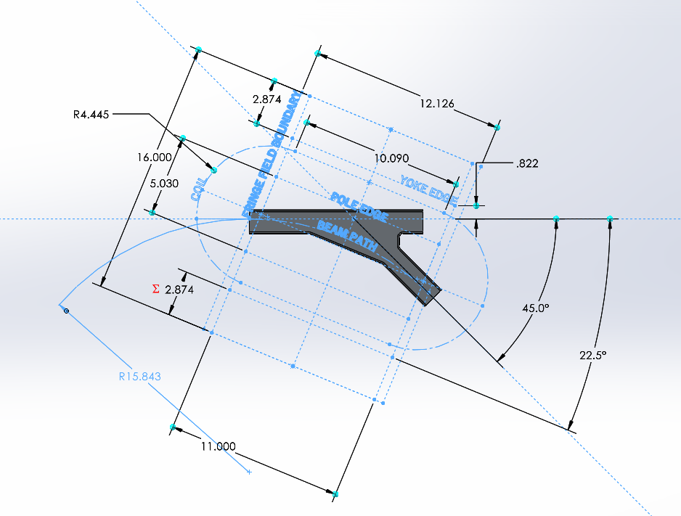
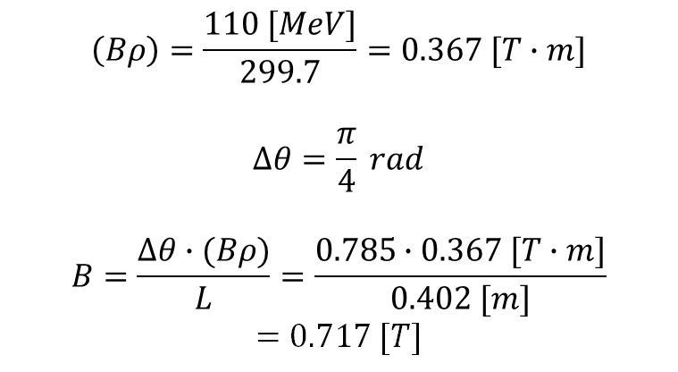
Set point calculation
$$\left(Bρ\right)=\frac{110 [MeV]}{299.7}=0.367 [T∙m]$$
$$∆θ=\frac{π}{4} rad$$
$$B=\frac{∆θ∙(Bρ)}{L}=\frac{0.785∙0.367 [T∙m]}{0.402 [m]}=0.717 [T]$$

Slide 3
Current vs Field fitting
A | B | C | D | E
Beam energy | Regidity | Magnetic Field (B_{y}) | Operating Current | Operating Current
MeV | T*m | T | A | A
 |  |  | Yung | Maksim
 | A/299.7 | 0.785398*B/0.402 | (C-0.0011)/0.0042 | 1.99766 + 222.84792*C + 19.67129*C^2
10 | 0.03337 | 0.06519 | 15.25938 | 16.60858
20 | 0.06673 | 0.13038 | 30.78067 | 31.38669
30 | 0.1001 | 0.19557 | 46.30195 | 46.33199
40 | 0.13347 | 0.26076 | 61.82324 | 61.44449
50 | 0.16683 | 0.32595 | 77.34453 | 76.72418
60 | 0.2002 | 0.39114 | 92.86581 | 92.17106
70 | 0.23357 | 0.45633 | 108.3871 | 107.7851
80 | 0.26693 | 0.52152 | 123.9084 | 123.5664
90 | 0.3003 | 0.5867 | 139.4297 | 139.5149
100 | 0.33367 | 0.65189 | 154.951 | 155.6305
110 | 0.36703 | 0.71708 | 170.4722 | 171.9134
120 | 0.4004 | 0.78227 | 185.9935 | 188.3634

Slide 4
Operating Current vs Beam energy
From slide 1 magnetic field calculation gamma ray window safety minimum operating current should be set to at least 9.28 A and to make it even 10 A.

